Slide 1

ROTARY BRANDING:
WHAT’S IN A NAME
Mary Lou Harrison and Laura Spear, Zones 28 and 32 RPICs
Liz Thaim, Global Advisor for Rotary Brand

Slide 2
AGENDA
At the end of this presentation, you’ll learn
Rotary logo refresher
How to use and protect the Rotary name and why it’s so important
Next steps if you already use the Rotary name
Resources
Questions & Answers
Notes:
At the end of this presentation, you’ll learn
A refresher on correct logo usage
How to use and protect the Rotary name and why it’s so important
Next steps if you are currently using the Rotary name or how to proceed if you want to use the Rotary name in your community
Q&A - we scheduled plenty of time to answer your questions!

Slide 3



ROTARY INTERNATIONAL LOGOS
Masterbrand Signature
Mark of Excellence
Masterbrand Signature Simplified
Notes:
Let’s start with some terminology.
This is Rotary’s logo, or what is referred to as the Masterbrand Signature. It consists of the word Rotary and the Rotary wheel. Below the MBS is the simplified logo. Either of these logos can be used as our Rotary logo.
Then, there’s the Mark of Excellence, which is the Rotary wheel on its own. It is always used in combination with the Masterbrand Signature, and is always depicted much larger than the Masterbrand Signature. Please notice that we don’t offer the simplified logo as the mark of excellence.
These elements are the base of Rotary’s visual identity. Every club, district, and program is to use the Masterbrand Signature its visual identity.
The logo cannot be manipulated. You wouldn’t manipulate any other brand’s logo.

Slide 4
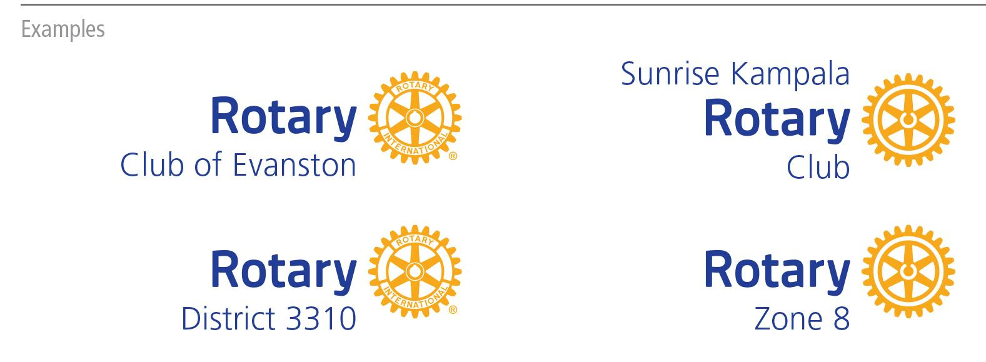
CLUB, DISTRICT, & ZONE LOGOS
Notes:
Only Rotary International can use the Masterbrand Signature on its own. Clubs, districts, multi-districts and zones can only use the Rotary logo with their club, district, or zone name. This applies to Rotary, Rotaract and Interact clubs.

Slide 5
Protect Rotary’s name and intellectual property​
Credit and recognize members, clubs, districts, and programs for the good work they do ​
Tell Rotary’s story in a consistent way
WHY IT’S IMPORTANT
TO USE THE ROTARY MARKS CORRECTLY
Notes:
Here’s why it matters for Rotary. And it’s not just Rotary, correct branding is important to every global brand. Think about your own business or other organizations you may be part of. Does it matter that your customers or clients can easily identify you or distinguish you from others? Rotary is no different.
Like Coca-Cola, McDonald’s, and UNICEF, we must protect our name and intellectual property. It’s how we can grow our organization, increase our impact, and maintain our reputation as an organization that can be trusted. Misuse of our logo only weakens our brand.
Second, when a local club uses the Masterbrand Signature with their club name, they get credit for their good work in the community while leveraging the power of the Rotary’s global brand.
And finally, our logo helps us tell Rotary’s story in a consistent and compelling way. It’s our visual identity, No matter where you are in the world, if you see a Rotary club logo, you know that club is part of an international network of people of action.

Slide 6
FOUR KEY GUIDING PRINCIPLES
Notes:
Now that you see why it’s important to use Rotary’s logos properly, let’s talk about how Rotary’s logo should be used. There are 4 guiding principles or rules that you should keep in mind.

Slide 7


1.
Always use a club or district identifier when using the Rotary logo. They must be aligned with the Rotary logo.
Notes:
Rule #1: Always use a club or district identifier when using the Rotary logo.
A club can use the name they are known by locally, adding their club name above or above and below the Masterbrand Signature, like you see here. The layout you choose depends on how you say your club’s name. Create your club logo in our logo creator in the Brand Center.

Slide 8



2.
Never obscure the Rotary wheel,
use a partial wheel, manipulate the wheel,
or use the wheel as
an object.
Notes:
Rule #2: Never obscure the Rotary wheel, use a partial wheel, or manipulate the wheel in any way. The Mark of Excellence should only be used with the Masterbrand Signature. Don’t manipulate Rotary’s logo by making it into a pancake, place it on top of an apple, as a bike wheel, or the number zero.

Slide 9



3.
Do not use images
or graphics within
the Rotary logo.
Notes:
Rule #3: Do not use images or graphics within the Rotary logo. Nike wouldn’t add a tree behind their swoosh, nor should we add anything extra to the Rotary club logo. You can add an image nearby your club or district logo, but it should never be part of the logo.

Slide 10




4.
Retire the previous version of the Rotary logo and all uniquely made club logos.
Notes:
And finally, rule #4: Replace your heritage logos with our new refreshed logos. We must tell a consistent story of who we are as members of Rotary, and what we do. That’s our brand. Using the updated brand standards ensure we do that.

Slide 11

Credit to Kathleen McNulty, District 5060
Notes:
For reinforcement, here is a video that Kathleen McNalty of District 5060 recently created (using pre-approved and publicly available photos).

Slide 12
Using the Rotary name correctly is just as important as using logos correctly​
Membership in Rotary doesn’t grant full access to the Rotary name​
Consider the risk, both legal and reputational
WHAT’S IN A NAME?
Notes:
Now that we are reminded about the basics of Rotary logo usage, let’s talk about the Rotary name. Just like we have rules about using the Rotary logo appropriately, we need to use the Rotary name correctly. Clubs and districts are given the right to use the Rotary logo when they add their identifier to it. However, clubs and districts do not have the right to simply use Rotary either as a logo or as a name of an event, a building, a clock, a park, a pool, and so on. By using the Rotary name, you are putting Rotary International at risk of responsibility and liability. Using the name Rotary implies that Rotary International is the sponsor and is responsible for ownership, maintenance, taxes and other financial commitments, as well as liability. For example, if someone gets injured at a Rotary Pool, Rotary International will be held responsible and can be sued.

Slide 13
ROTARY NAME MIS-USE
Rotary Stadium, Botanic Rotary Gardens, Rotary Clock
Rotary Run, Rota-fun Days, Rotary Food Drive
Rotary Charities, Interact Camp for Kids
Rotaractors For a Better World!
www.rotarysaveslives.com
Notes:
Consider the following uses of the Rotary name. We see clubs and districts often using the Rotary name incorrectly. We know these are usually innocent mistakes - people just aren’t aware of the policies and guidelines and want to create visibility for Rotary in their local community.

Slide 14
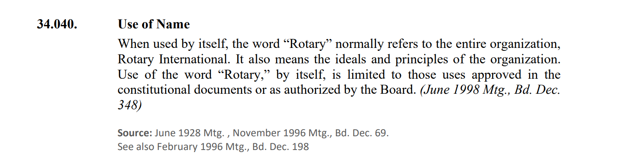
ROTARY POLICIES ON NAMING
Rotary’s Code of Policies​
34.040.2. Use of Rotary Marks in Connection with Buildings and Other Permanent Structures
Notes:
You can find the rules for using Rotary’s name in the Rotary Code of Policies. Section 34.040 contains all kinds of information about how clubs and districts should use the Rotary name. Section 34.040.2 specifically calls out the rules for using the Rotary name on buildings and other permanent structures like clocks, towers, and so on.

Slide 15
IF SOMETHING IS ALREADY NAMED…
Reach out to Liz Thiam (Global Advisor for the Rotary Brand) for a conversation: You can work through Mary Lou and Laura
Identify whom from your club and district should be involved
  You will need your District Governor’s support and advocacy!
Look through contracts and other legal documents to see if the Rotary name is used
Discussion with Liz will determine next steps
Notes:
If your club or district already has something that uses the Rotary name, please work with Laura and Mary Lou, who will connect you with Liz Thiam, Rotary’s Brand Specialist. They will need some key information for a review, including whom should be involved and whether Rotary is specifically called out in legal papers such as contracts and articles of incorporation. Liz will work with you to understand the scope of liability and recommend actions based on the review.

Slide 16
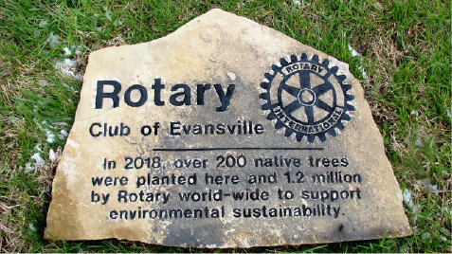
ALTERNATIVE SOLUTIONS
Adjacent sign with your club or district logo, ideally with a Call to Action
“Sponsored by” your club or district name
Notes:
You do have other options to get recognition and awareness for your role. You can create an adjacent sign that acknowledges your club or district’s support. You can use words like “sponsored by” in your signs, posters, and press releases. In this example, you can see that the Rotary Club of Evanston uses the proper club logo and highlights its role in planting over 200 trees for environmental sustainability rather than calling the program something like Rotary Trees.

Slide 17
RESOURCES
Brand Center - brandcenter.rotary.org​
Your Logos at a Glance pdf (on Brand Center)
rilicensingservices@rotary.org
Learning Center courses
Rotary’s Code of Policies​
Email brand@rotary.org for questions
Notes:
In addition to the Code of Policies, Rotary has a lot of resources to help you understand and use our Marks correctly.
If you have a question, contact Mary Lou or Laura or send it to brand@rotary.org.

Slide 18
YOUR ZONE COORDINATORS
Laura Spear
Rotary Public Image Coordinator Zone 32, 2023-2024
laura@spear.net – best way to reach me!
508-353-8228 cell/text
Mary Lou Harrison
Rotary Public Image Coordinator Zone 28, 2023-2024
rotarianmarylou@gmail.com
Notes:
Keep in mind that Mary Lou and Laura are your primary interface into Rotary International. We’re here to help.

Slide 19

QUESTIONS

